Slide 1
Quarterly Foodservice Reports and Trends
Q4 2025

Slide 2
Industry Data/Performance
Operator and Consumer Survey Data
2026 Sales and Flavor Forecasts
Distributors
Contents
Full reports can be found on the Foodservice Teams page below:
Foodservice Reports

Slide 3
Industry Performance, and Operator Reporting and Concerns

Slide 4
Consumer Price Index - Food
Away-from-home food is still seeing higher inflation vs. at-home, however the gap is closing over the past few months
Sept. 2025
Food Away From
Home Inflation
3.7%
Sept. 2025
Food At Home
Inflation
2.7%
Source: Bureau of Labor Statistics and Technomic

Slide 5
Openings and Closings
RESTAURANT OPENINGS & CLOSINGS: ALL RESTAURANTS
Permanent Closures:
JUL '25: 1,268 units
New Openings:
JUL '25: 2,612 units
Total Active Restaurants:
JUL '25: 861,410 units
JAN ‘23
JUL '25
RESTAURANT OPENINGS & CLOSINGS: CHAINS
RESTAURANT OPENINGS & CLOSINGS: INDEPENDENTS
Permanent Closures:
JUL '25: 237 units
New Openings:
JUL '25: 886 units
Permanent Closures:
JUL '25: 1,031 units
New Openings:
JUL '25: 1,726 units
JAN ‘23
JUL '25
JAN ‘23
JUL '25
Source: Datassential

Slide 6
Operator Business Expectations
OPERATOR: TRAFFIC EXPECTATION FOR MOST RECENT MONTH
Will Be Higher:
SEPT '25: 50%
Will Be the Same:
SEPT '25 : 38%
Will Be Lower:
SEPT '25: 12%
OPERATOR: SALES EXPECTATION FOR MOST RECENT MONTH
Will Be Higher:
JUL '25: 52%
Will Be the Same: JUL '25 : 36%
Will Be Lower:
JUL '25: 12%
Source: Datassential

Slide 7
Operator Challenges and Profit Strategies
WHAT ARE OPERATORS’ TOP OPERATIONAL CHALLENGES?
WHAT KINDS OF PROFITABILITY STRATEGIES HAVE OPERATORS IMPLEMENTED?
 | AUG '25 | SEP '25 | 1-mo. change
Food costs | 78% | 76% | -1%
Labor costs | 57% | 49% | -8%
Labor recruitment / hiring | 29% | 33% | 4%
Retaining current staff | 29% | 31% | 1%
Customers reducing how much they spend | 18% | 27% | 9%
Customers reducing how often they visit | 17% | 22% | 5%
New sources of competition in my area | 7% | 10% | 2%
Marketing / promoting our business | 6% | 8% | 3%
New laws or regulations | 10% | 8% | -2%
Sourcing challenges / ingredient shortages | 6% | 7% | 1%
Innovating / updating our menu | 6% | 4% | -1%
Other | 2% | 3% | 0%
 | AUG '25 | SEP '25 | 1-mo. change
Launched new items / LTOs | 30% | 32% | 2%
Raised menu prices | 27% | 30% | 3%
Focused on value | 23% | 30% | 6%
Invested in technology / automation | 16% | 15% | 0%
Reduced menu size | 15% | 15% | 0%
Sourcing more online from suppliers | 12% | 15% | 2%
Transitioned toward off-premise | 11% | 12% | 1%
Switched / added new distributors | 12% | 8% | -3%
Reduced hours of operations | 11% | 8% | -4%
Reduced seating capacity | 5% | 4% | -1%
Source: Datassential

Slide 8
2026 Sales and Flavor Forecasts

Slide 9
Consumer Spend by Year
Prepared food and non-alcoholic beverages (billions)
From 2021 to 2026 25% real growth….and 75% inflationary growth
$978.8
$940.4
$855.3
$897.8
$790.0
Inflationary growth
real growth
Source: Datassential

Slide 10
2026 Projected Growth by Segment
1.1%
overall industry projected real growth
Prepared food and non-alcoholic beverages
Real growth = adjusted for inflation
Source: Datassential

Slide 11
New Classics for 2026 - Flavors/Ingredients
10 New Classics for 2026 is comprised of foods, flavors, and beverages that have become
“new classics.”
These items may not be “new,” per se, but they’re now cemented as a must-have for many consumers and can be leveraged across segments and retailers. Some New Classics also earned their spot on this list because they’re “old dogs” who have learned “new tricks” – such as tomato, a ubiquitous ingredient, that is being used in new, unexpected ways. This list is by no means exhaustive, but it should be considered as you build out menu and retail strategies for 2026.
Basque Cheesecake
What it is: A type of cheesecake with an intentionally golden-brown “burnt” top that gives way to a creamy, custardy, mousse-esque texture inside.
Lemon Pepper
What it is: A spice blend featuring dried lemon zest, black pepper, and salt that’s taking off in categories like chicken wings.
Butter Chicken
What it is: An Indian dish featuring chicken in a mild curry with a tomato and butter or heavy-cream base. It’s now appearing as a flavor for items ranging from pizza to burgers.
Smashed
What it is: From smashed potatoes to smashburgers to smashed cucumber salads, the smashing technique has gone viral on social media and is a simple yet effective method for increasing flavor.
Hot Honey
What it is: A hallmark of the “swicy” (sweet and spicy) trend, hot honey is a sweet-meets-spicy condiment made by infusing honey with chiles.
Tomato in Unexpected Applications
What it is: Tomatoes, which are on 85% of menus, are being used in unexpected ways – think “tomato dust” garnishing cocktails/mocktails or starring in desserts or smoothies.
Birria
What it is: Traditional birria is made with stewed goat, but it has evolved into a social media sensation featuring tacos filled with beef and cheese. New iterations such as birria pizza or birria burgers are increasingly popping up.
Texture in Food/Beverages
What it is: Whether it’s tapioca pearls, jelly cubes, or red beans in boba or crispy kataifi in Dubai chocolate, expect the unexpected as more foods and beverages are being studded with textures that add to the experience.
Ube
What it is: A purple, Filipino potato that can be used as a blank canvas and add social media-worthy color to everything from cloud lattes to croissants.
Monosodium Glutamate (MSG)
What it is: The tide is turning on once-misunderstood MSG, which can add umami to nearly any dish or beverage.
Source: Datassential

Slide 12
Operator Menu Data
WHAT NEW CLASSICS ARE OPERATORS OFFERING? WHICH DO THEY WANT TO OFFER?
 | Currently offer it | Don’t offer it but interested | Don’t offer it and not interested
Lemon Pepper | 50% | 25% | 25%
Hot Honey | 41% | 35% | 23%
Smashed | 30% | 34% | 37%
Unique Texture in Foods/Beverages | 17% | 35% | 48%
Monosodium Glutamate (MSG) | 17% | 22% | 62%
Butter Chicken | 16% | 37% | 47%
Birria | 16% | 35% | 50%
Basque Cheesecake | 10% | 44% | 47%
Tomato in Unexpected Applications | 8% | 29% | 63%
Ube | 7% | 27% | 65%
Source: Datassential

Slide 13
Future Flavors for 2026
Our list of 10 Foods, Flavors, & Beverages for the Future walks the line between innovative/trend-forward yet approachable and rooted in reality.
How does one decide which “out there” food, flavor, or beverage is “out there” enough to be unique, but not so out there that it’s not even worth talking about? It’s the difference between something like fermented black beans, which is unlikely to ever be in Ubiquity on the MAC, but also has more traction going than, say, ant yogurt. Not all of the following foods, flavors, and beverages will be right for every business, but we’ve worked to balance some farther out trends (grass jelly) with more widely-applicable nearer-term trends (piloncillo).
Stracciatella
What it is: A fresh, creamy, Italian cheese made from shredded mozzarella and cream that’s the luscious filling inside burrata and could be used as an elevated swap anywhere burrata or fresh mozzarella are used.
Camu kadaifi
What it is: This small Brazilian berry has the potential to be the next big superfood, as it boasts high levels of vitamin C and antioxidants. It’s typically mixed into smoothies.
Char Siu
What it is: A classic Chinese preparation featuring red-hued, sweet and savory BBQ pork that can be applied to a variety of different animal proteins.
Piloncillo
What it is: Lean into piloncillo as consumers turn to natural sugars. This Latin American brown sugar can add complex notes of caramel and molasses to everything from drinks like café de olla to baked goods.
Peruvian Black Mint (Huacatay)
What it is: Peruvian black mint has notes of mint, citrus, basil, and tarragon and could add global flair to any dish or beverage featuring traditional mint. It also stars in aji de huacatay, a green sauce/salsa that could be the next chimichurri.
Ataya Tea
What it is: A Senegalese tea made with gunpowder green tea leaves, sugar, and mint, and features a foamy top that could appeal to lovers of coffee foam while also capitalizing on the teatime trend.
Som Tum
What it is: Sweet, spicy, sour, and salty som tum is a quintessential Thai green papaya salad that can be easily customized to meet a variety of consumer preferences and serve as flavor inspiration for beverages.
Ancient Grain Beer
What it is: Combining beer with health and sustainability-forward trends, ancient grain beer is brewed with ancient grains such as African fonio or quinoa.
Fermented Black Beans
What it is: Black soybeans that have been fermented with salt and a fermenting agent similar to koji. While often used in a sauce to add funk to dishes, fermented black beans can also be used whole to add texture.
Grass Jelly
What it is: Made with Chinese mesona (an herb that’s part of the mint family), this jet-black jelly dessert is often featured as a topping/add-in to beloved boba.
Source: Datassential

Slide 14
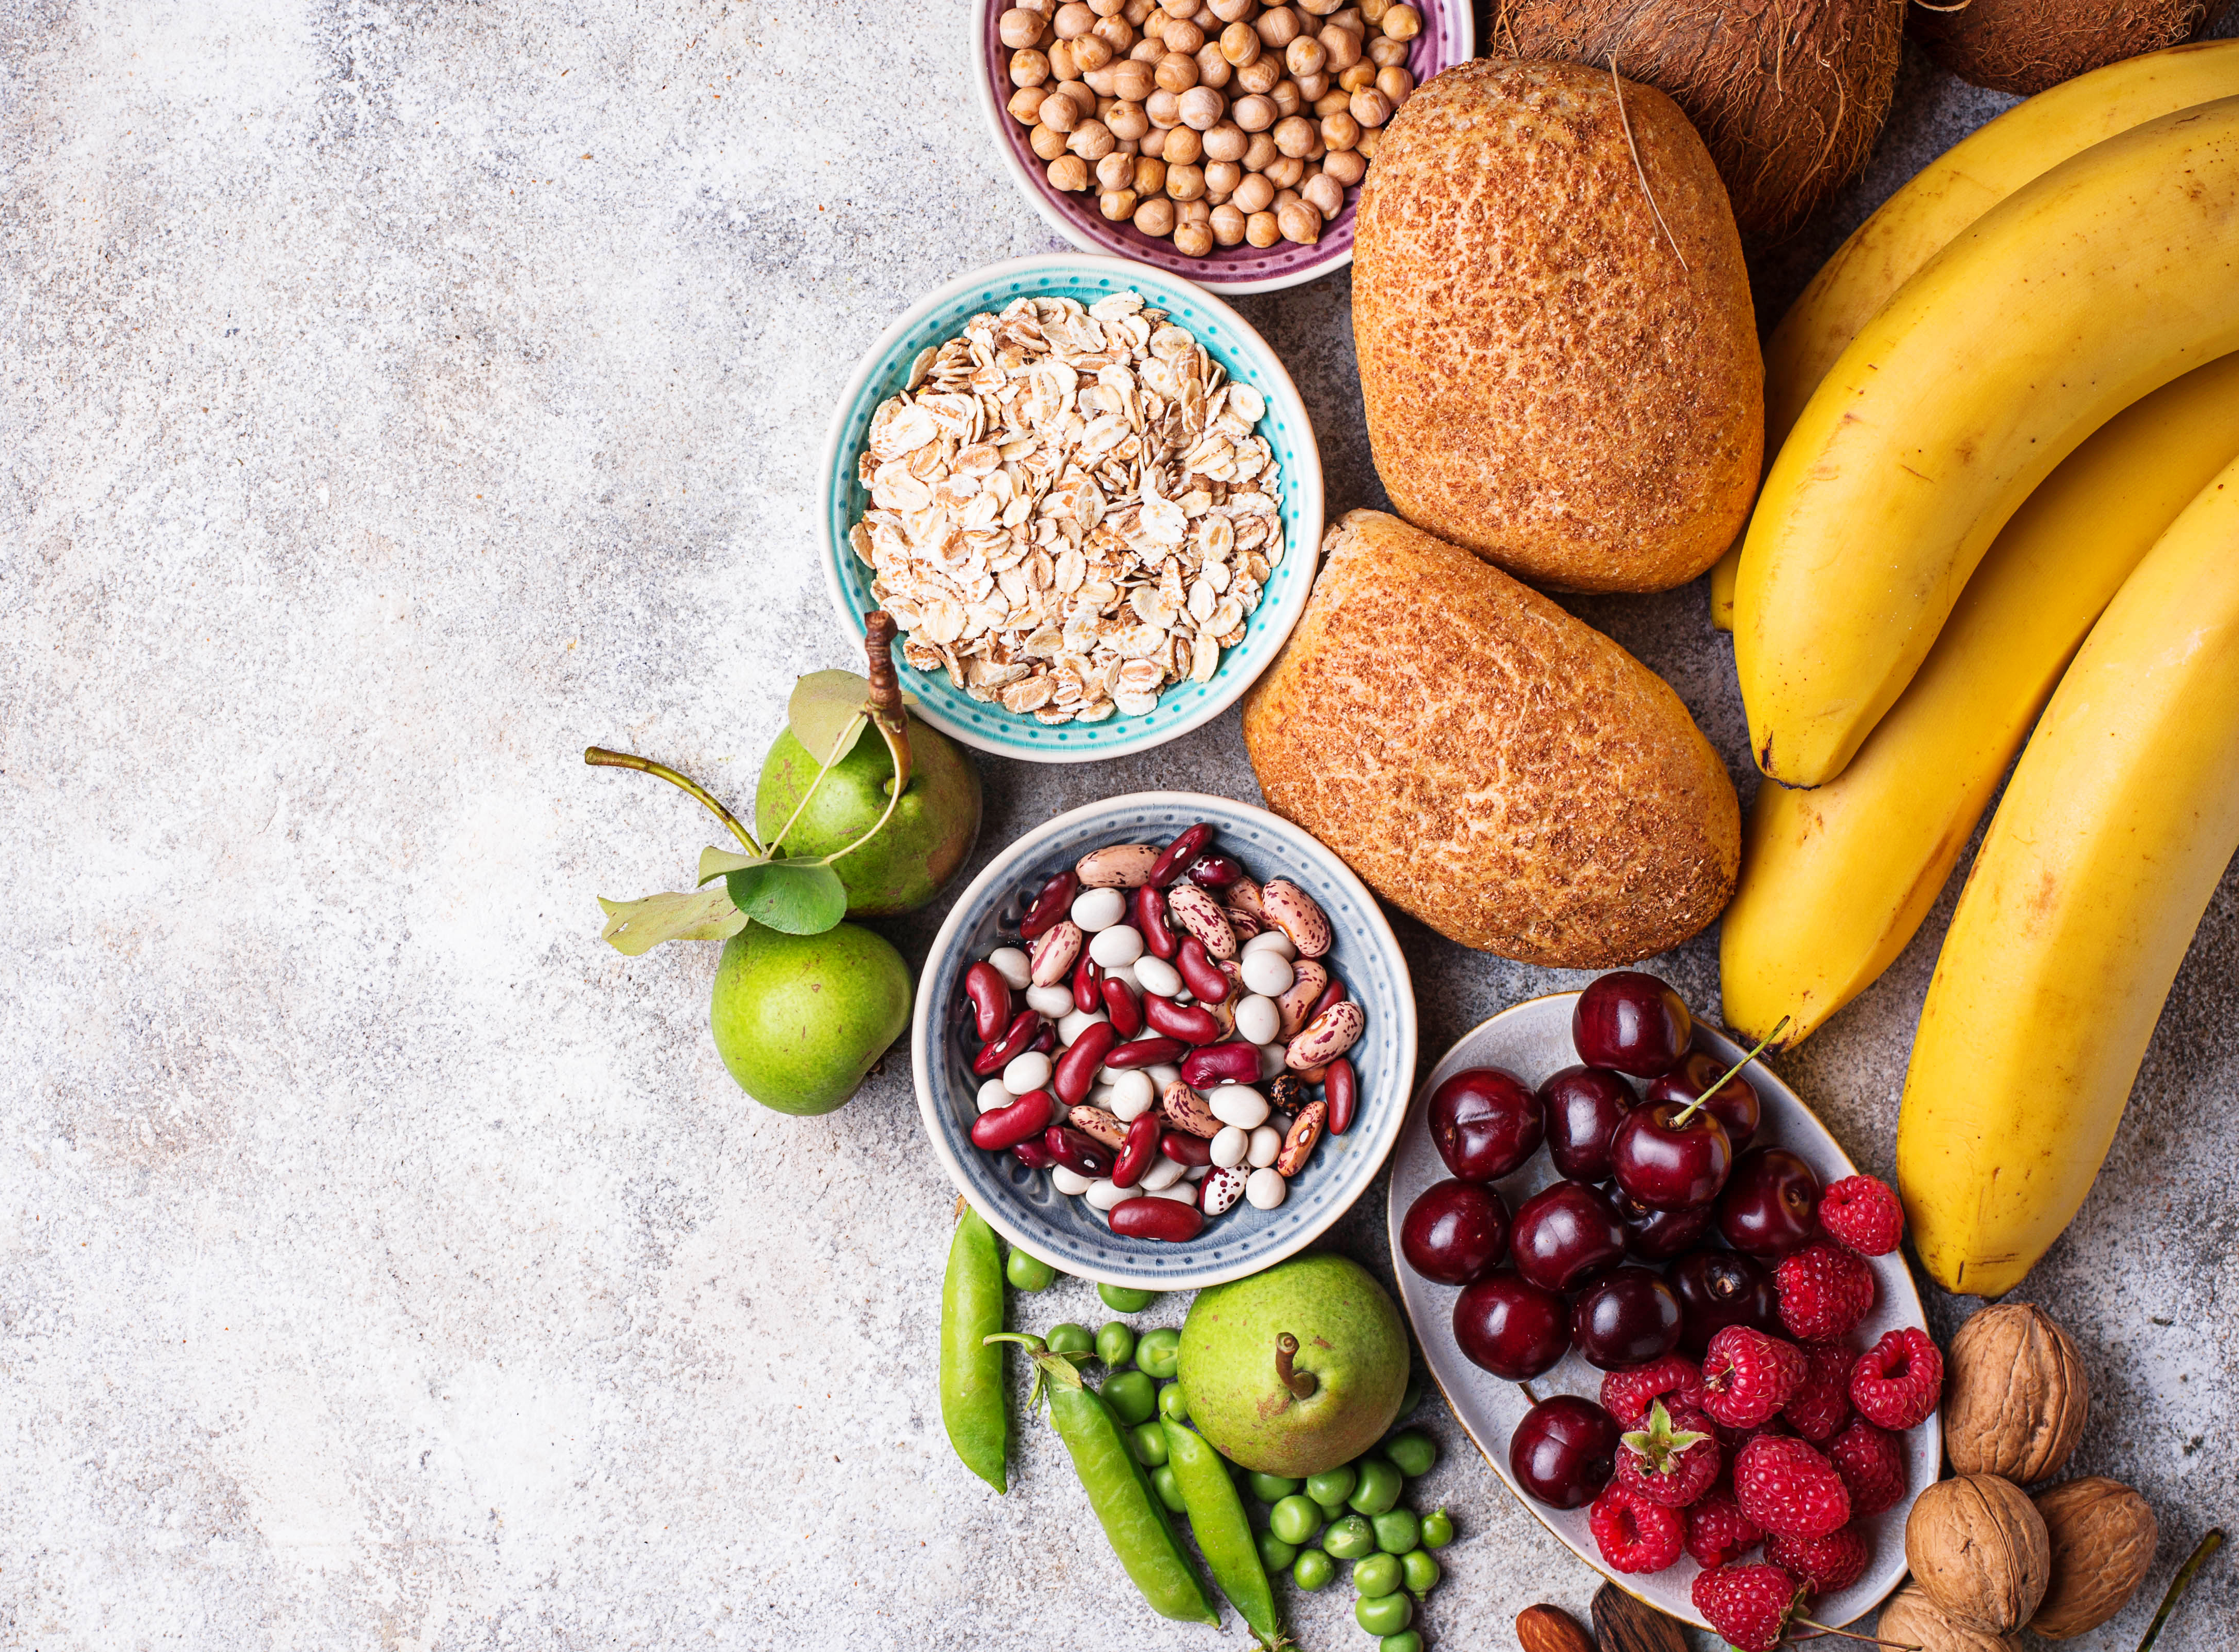
Uptick in Fiber Interest
FIBER TO THE MAX
FIBER IS THE NEW PROTEIN
What it is: Gut health and GLP-1s are trending, and with that, manufacturers and retailers are focusing on fiber (which can naturally increase the GLP-1 hormone in the body) and calling it out on food/beverage packaging. Fibermaxxing, a TikTok trend where consumers try to fit as much fiber as possible into a recipe or dish, is further propelling the fiber trend.
Why it matters: Fiber is set to be the next big health trend following on the heels of protein, particularly at retail, where new products are popping up highlighting fiber in relation to gut health. Notably, over half of consumers say that when thinking about their health in 2026, consuming more foods/beverages for gut health will be important to them.
Where to find it: Retail
Source: Datassential

Slide 15
Consumers looking for Fiber
When Datassential asked consumers how important various attributes were when thinking about their health in 2026, increasing fiber intake was behind increasing protein intake only by a tiny (nearly negligible) margin – 51% compared to 52% – indicating a shift from protein being the big health trend to fiber.
In line with the growth of the overarching gut health trend and the rise of GLP-1s, fiber (which can naturally increase the GLP-1 hormone in the body, according to NPR, with some fibers ”more potent at triggering GLP-1 release and at regulating hunger than others”) could overtake protein in the year(s) ahead as a primary callout on products at retail.
A new type of diet called fibermaxxing has taken off on TikTok, which could further propel the fiber trend forward. While fibermaxxing isn’t widely recognized yet (only 12% of consumers overall know what it is, but that number jumps to 21% of Gen Z), once consumers know what it involves (simply maximizing fiber intake by making high-fiber recipes and consuming high-fiber foods/beverages), 52% are interested in trying it, revealing that there’s a broad market for high fiber products and the concept of fibermaxxing.
Operators are not currently taking advantage of the fiber trend – only 22% say they already offer high-fiber items and promote that to patrons – making it a missed opportunity.
Source: Datassential

Slide 16
Consumer and Operator
There’s a clear gap when it comes to consumer interest in foods/beverages featuring health-forward attributes like fiber and operators who are marketing or highlighting it on menus and product labels.
How interested are consumers in foods/beverages with the following health-related attributes?
Are operators promoting foods/beverages they already offer with the following health-related attributes to patrons?
 | Offer items with this and promote that to patrons | Already offer items with this, but do NOT promote it to patrons | Don’t offer items with this
High protein | 38% | 46% | 16%
Allergen-free | 32% | 39% | 29%
Low-sugar | 29% | 42% | 29%
Low-carb | 28% | 44% | 27%
Low-fat/fat-free | 28% | 45% | 27%
High fiber | 22% | 41% | 37%
No artificial flavors/dyes/preservatives | 21% | 45% | 34%
Low-sodium | 20% | 48% | 32%
Low cholesterol | 18% | 45% | 37%
High in healthy fats/omega-3s | 17% | 43% | 40%
Rich in vitamins/minerals | 17% | 48% | 35%
LEFT: How interested are you in foods/beverages with the following attributes? (n=1005 consumers | top-2, 5 pt. scale). Fielded September 2025.
RIGHT: For each of the following, do you…? (n=359 operators). Fielded September 2025.
Source: Datassential

Slide 17
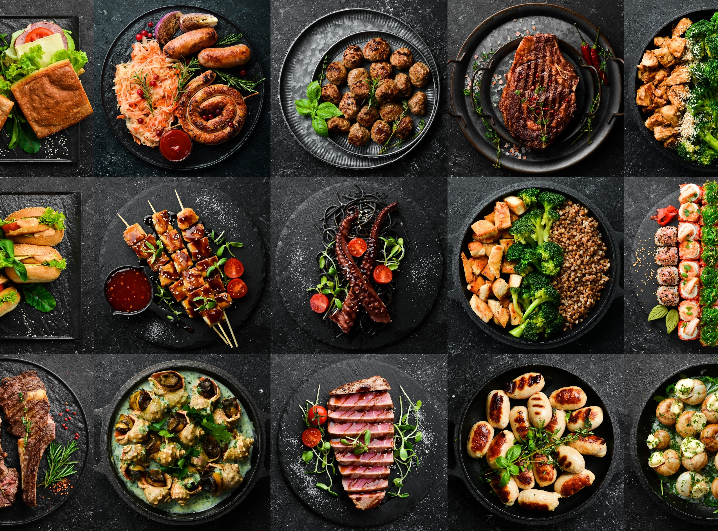
Meat Focused
MEAT’S BACK ON THE MENU
PLANT-BASED MEAT HAS PLATEAUED
What it is: Plant-based meat and seafood products have plateaued, both in retail store sales as well as in terms of consumer sentiment. Many consumers are getting back to basics and returning to eating animal meats such as beef, poultry, and pork.
Why it matters: Now is the time to rethink your protein strategy as consumers are shifting back toward animal meat as well as seeking out center-of-plate vegetables (cauliflower steaks, etc.) that simply let garden goodies shine.
Where to find it: Retail & foodservice
Source: Datassential

Slide 18
Consumer and Operator Opinions
72%
OF CONSUMERS SAY ANIMAL MEAT IS MORE SATISFYING TO THEM THAN PLANT-BASED MEAT ALTERNATIVES
OF CONSUMERS SAY THAT, IN GENERAL, ANIMAL MEAT IS MORE “NATURAL” TO CONSUME THAN PLANT-BASED MEAT
65%
34%
OF CONSUMERS SAY THAT WHEN THINKING ABOUT THEIR HEALTH IN 2026, IT WILL BE IMPORTANT TO THEM TO CONSUME MORE ANIMAL MEAT
61%
OF CONSUMERS AGREE ANIMAL MEAT IS MORE VERSATILE THAN PLANT-BASED MEAT
72%
OF OPERATORS SAY EVEN IF PRICES ARE HIGHER ON ANIMAL MEAT, THEY GET MORE “BANG FOR THEIR BUCK” WITH ANIMAL PROTEIN
59%
OF CONSUMERS SAY THEY REGULARLY CRAVE ANIMAL MEAT – EVEN IF THEY DON’T CONSUME IT
Source: Datassential

Slide 19
What Does it Mean to Operator/Manufacturer
Overall, the plant-based meat category has stalled, and consumers are turning back to animal meat.
Some of the key factors propelling animal meat back to the forefront as plant-based meat plateaus include the following:
Millennials are largely leading the charge back to animal meat, spurred by factors such as how over 40% have kids (think about the inherent meatiness of many kids’ diets, from meatballs to chicken nuggets).
Most consumers see animal meat as more natural (65%) and satisfying (72%) compared to plant-based meat.
Despite innovation, 67% of consumers say there are dishes where plant-based meat will just “not ever” replace the comfort, texture, or taste of animal meat.
Price is a determining factor for choosing animal meat for 61% of consumers (versus 43% who say the same for plant-based meat).
While many consumers crossed the road to see what all the fuss about plant-based chicken and meat was all about, most have made up their minds that sometimes, nothing beats the “real thing” – 72% of consumers say animal meat is more satisfying than plant-based meat alternatives, and 67% say there are dishes where plant-based meat just won’t cut it and can’t replace the comfort, texture, or taste of animal meat.
If you’re a manufacturer, lean into animal meat and highlight its versatility. Operators (88%), in general, see animal-based meat as a long-term trend, while 55% believe meat alternatives are a short-term fad that’s fizzling out. Two-thirds of operators also say animal meat is more versatile than plant-based meat, making versatility a talking point to hit home when looking to sell animal-based meat offerings.
Source: Datassential

Slide 20
Operator Data
WHAT TYPES OF PROTEIN DO OPERATORS OFFER? WHAT DON’T THEY WANT TO OFFER?
% OF OPERATORS THAT CURRENTLY OFFER WITH
NO PLANS TO CHANGE
% OF OPERATORS WHO DON’T OFFER AND ARE NOT INTERESTED IN OFFERING
Beef – 67%
Poultry – 67%
Pork – 57%
Sausage/Hot Dogs – 57%
Plant-Based Seafood – 60%
Plant-Based Pork – 54%
Wild Game – 52%
Plant-Based Sausage/Hot Dogs – 51%
Source: Datassential

Slide 21
Power 50 Broadline Distributors
Report
November 2025

Slide 22
Top Broadliners Sales and Growth
TOP 10 BROADLINE DISTRIBUTORS
RANKED BY U.S. SALES VOLUME
Rank | Company Name | 2024 U.S. Sales ($B) | Annual Change %
1 | Sysco | $64.6 | 4.2%
2 | Performance Food Group | $60.1 | 3.9%
3 | US Foods | $37.9 | 6.4%
4 | Gordon Food Service | $22.7 | 5.7%
5 | Restaurant Depot | $10.2 | 5.5%
6 | Ben E. Keith | $7.4 | 6.0%
7 | Shamrock Foods | $6.0 | 5.4%
8 | The Chefs’ Warehouse | $3.8 | 10.5%
9 | Labatt Food Service | $1.8 | 4.1%
10 | GS Foods Group | $1.6 | 10.1%
Source: Datassential

Slide 23
Market Share – Share of Power 50
Power 50 sales share continues to consolidate
Source: Datassential

Slide 24
Case Volume – Annual Growth %
CASE VOLUME PERFORMANCE
YEAR-OVER-YEAR CHANGE
Cheney Brothers Acquisition
Source: Datassential

Slide 25

Foodservice Buyer in 2025
11% - Gen Z (18-31)
59% - Millennials (32-47)
18% - Gen X (48-58)
12% - Baby Boomers (59-78)
42
Median age of the foodservice buyer
Source: Datassential

Slide 26
Generational Differences
% of Operators Who look to Distributor Sales Reps for Information
Generational differences exist for information sources
All Generations
Distributor website/apps (tie)
Distributor sales representative (tie)
General internet search
Manufacturer website/apps
Millennial
Distributor website/apps
General internet search
Distributor sales representative
Manufacturer website/apps
Gen Z
General internet search
Distributor website/apps
Manufacturer website/apps
Manufacturer sales reps
Source: Datassential

Slide 27
Thank You
For any questions, or for further detail on any topics, please email
Ryan.Barnett@Seaboardfoods.com

